Slide 1


Title: Data Privacy and Regulation
Subtitle: Protecting Personal Information in the Digital Age
Present by: Gargi Kahar

Slide 2
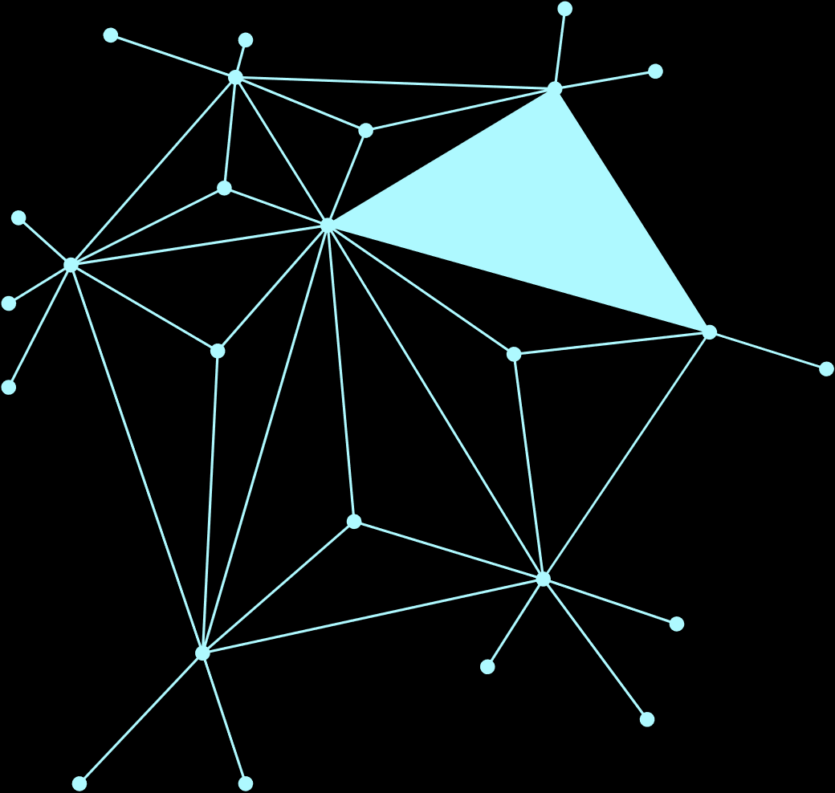
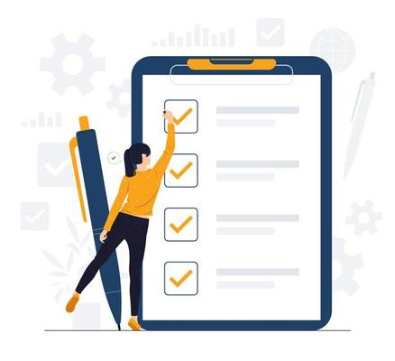
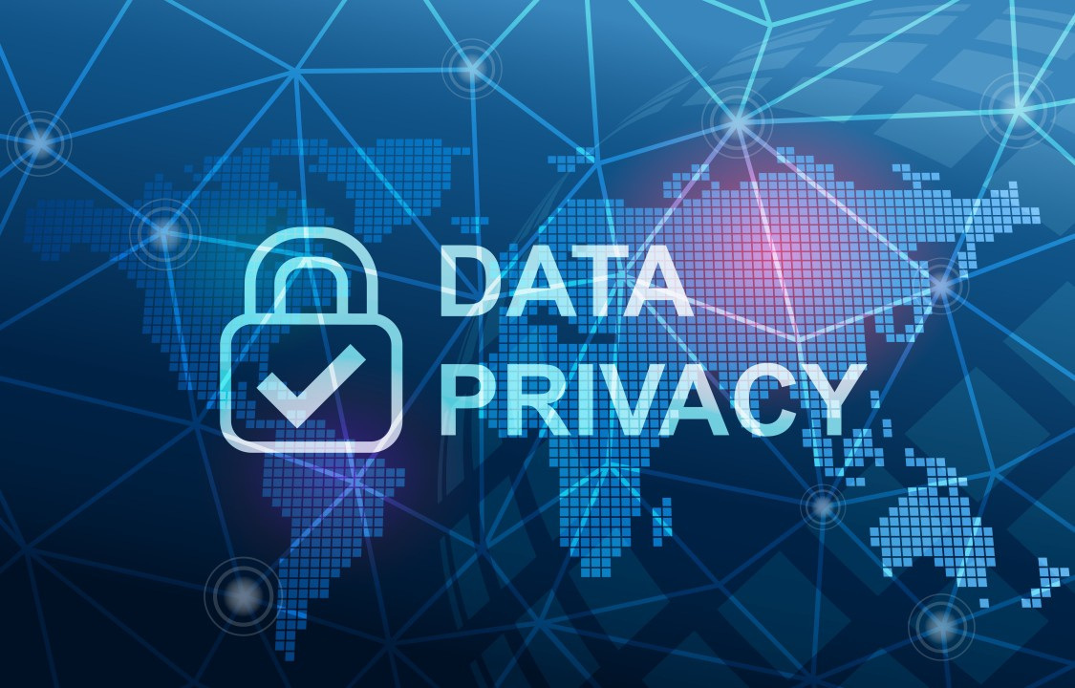
INTRODUCTION
What is Data?
Personal data includes different types of information, such as name, email, location, phone number, and photos.
Why Privacy Matters?
Data privacy is important for protecting this personal information from misuse and for making sure people's rights and safety are respected in the digital world.

Slide 3
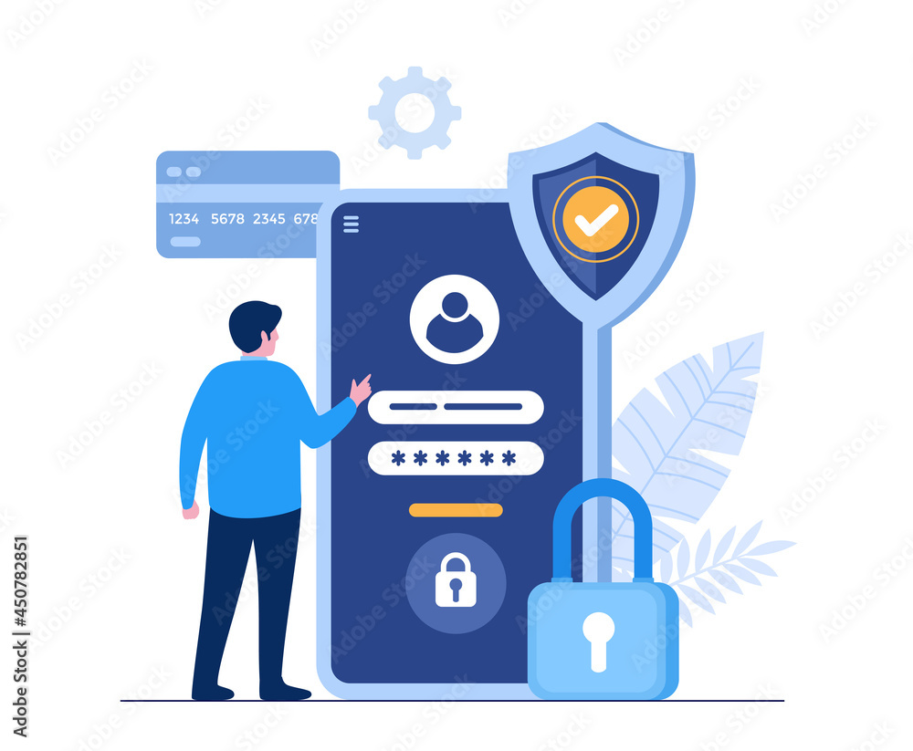
What kind of data needs privacy?
Contact Info (name, phone, email)
Location (GPS, IP)
Health & Finance Data
Browsing & Shopping Activity
Social Media Activity

Slide 4
Types of Personal Data Collected by Businesses
Information
30
10
Health and Sensitive Data
%
%
10
Social Media Activity
%
20
15
Purchase History
Browsing Behavior
%
%
15
%
Location

Slide 5

Data Regulations & Laws
What is Regulation & Laws?
Regulation means official rules made by the government or law.
These rules tell companies:
Data Collection
Data Usage
Consent
Security
Data Breach Notification
Some key regulatory frameworks include:
GDPR (General Data Protection Regulation) in Europe
CCPA (California Consumer Privacy Act) in the U.S.
DPDP Act (2023) (Digital Personal Data Protection Act) : in India

Slide 6

Advantages
Increases transparency
Protects
users
Privacy laws make sure that our sensitive information—like health data, financial records, or personal contacts—is not misused.
When users feel their data is handled responsibly, they are more likely to trust and continue using the service.
Avoids legal problems
Builds trust

Slide 7

Privacy laws make sure that our sensitive information—like health data, financial records, or personal contacts—is not misused.
When users feel their data is handled responsibly, they are more likely to trust and continue using the service.
Advantages
Increases transparency
Protects
users
Avoids legal problems
Builds trust

Slide 8

Privacy laws make sure that our sensitive information—like health data, financial records, or personal contacts—is not misused.
When users feel their data is handled responsibly, they are more likely to trust and continue using the service.
By following data protection laws, companies can avoid fines, penalties, and lawsuits.
Laws require companies to inform users about how their data is collected and used.
Advantages
Increases transparency
Protects
users
Avoids legal problems
Builds trust

Slide 9
Privacy laws make sure that our sensitive information—like health data, financial records, or personal contacts—is not misused.
When users feel their data is handled responsibly, they are more likely to trust and continue using the service.
By following data protection laws, companies can avoid fines, penalties, and lawsuits.
Laws require companies to inform users about how their data is collected and used.
Advantages
Increases transparency
Protects
users
Avoids legal problems
Builds trust

Slide 10

Disadvantages
Global Differences
High Costs
Meeting privacy law standards often requires big investments in security systems, audits, legal advice, and staff training.
Small and medium enterprises (SMEs) may struggle to understand or implement all the legal requirements.
Global Differences
Challenges

Slide 11

Meeting privacy law standards often requires big investments in security systems, audits, legal advice, and staff training.
Small and medium enterprises (SMEs) may struggle to understand or implement all the legal requirements.
Different countries have different laws—like GDPR in Europe, CCPA in the U.S., and DPDP in India.
Disadvantages
Global Differences
Global Differences
High Costs
Challenges

Slide 12

Meeting privacy law standards often requires big investments in security systems, audits, legal advice, and staff training.
Small and medium enterprises (SMEs) may struggle to understand or implement all the legal requirements.
Different countries have different laws—like GDPR in Europe, CCPA in the U.S., and DPDP in India.
Disadvantages
Conclusion
High Costs
Global Differences
Challenges

Slide 13

Meeting privacy law standards often requires big investments in security systems, audits, legal advice, and staff training.
Small and medium enterprises (SMEs) may struggle to understand or implement all the legal requirements.
Different countries have different laws—like GDPR in Europe, CCPA in the U.S., and DPDP in India.
“Data privacy is not just about laws—it’s about respecting people’s rights in a digital world.”
Conclusion
Conclusion
High Costs
Global Differences
Challenges

Slide 14
THANK YOU

